Slide 1
Random Forests Explained*
Damian A. Tamburri, Ph.D.
*slides courtesy of JADS

Slide 2
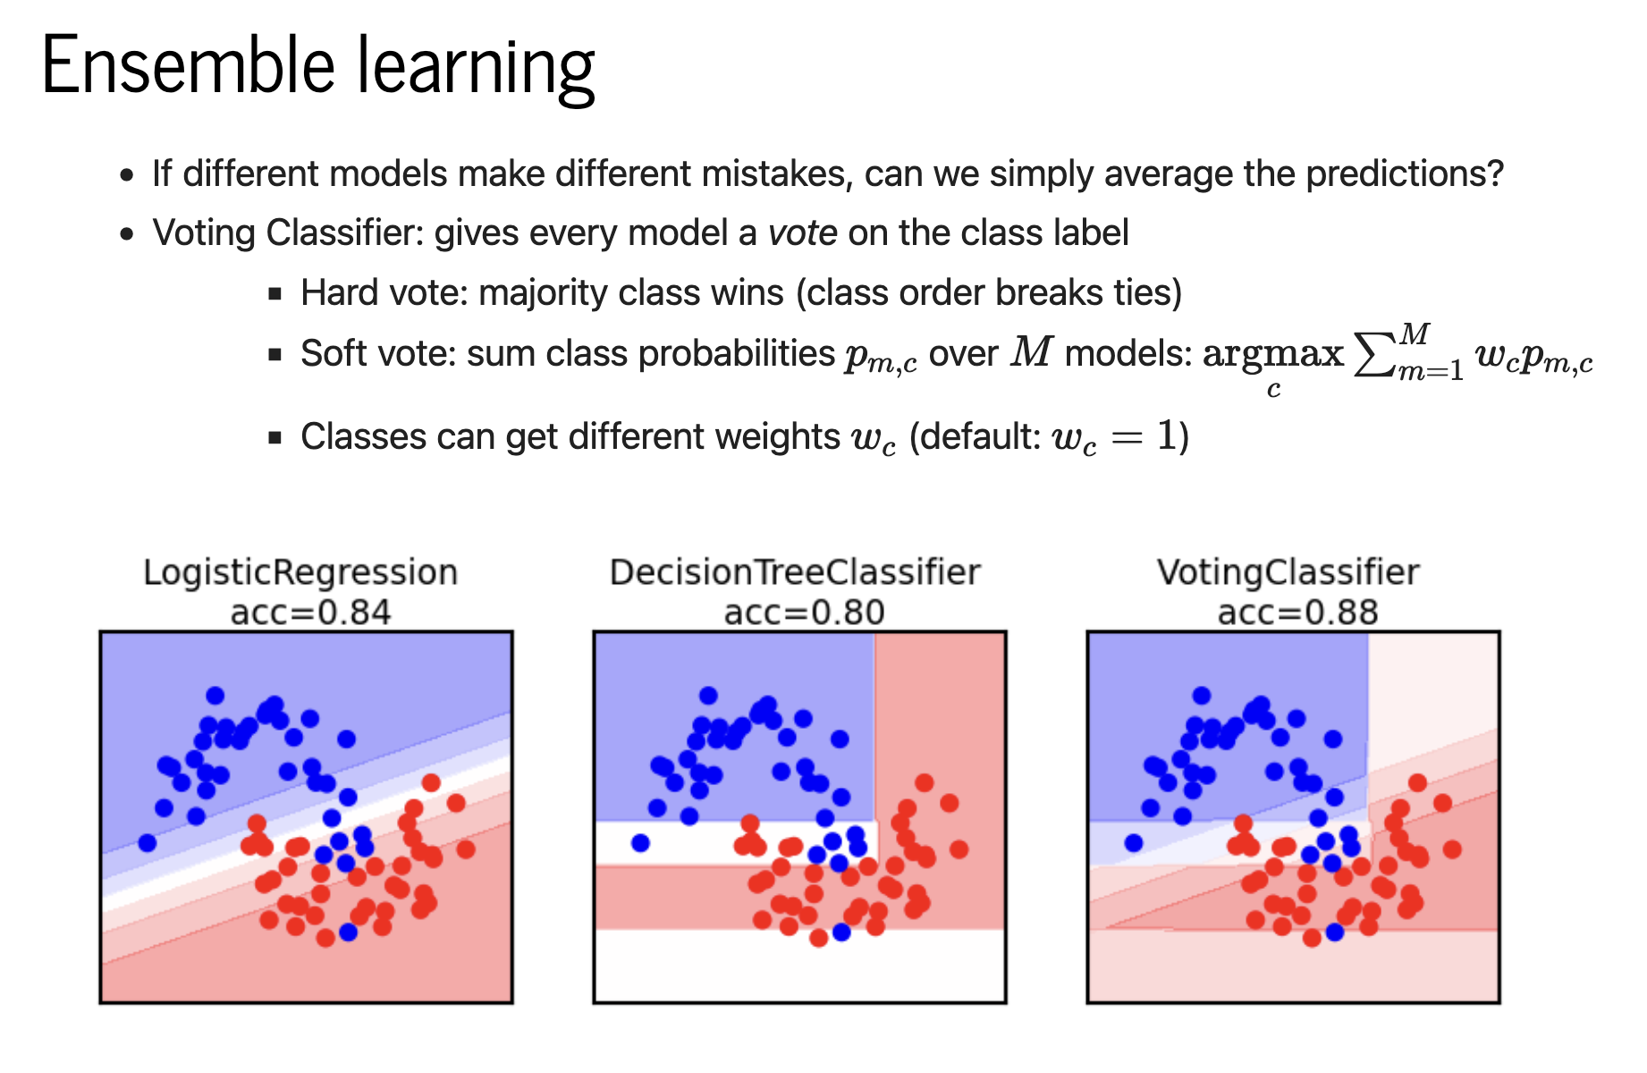

Slide 3
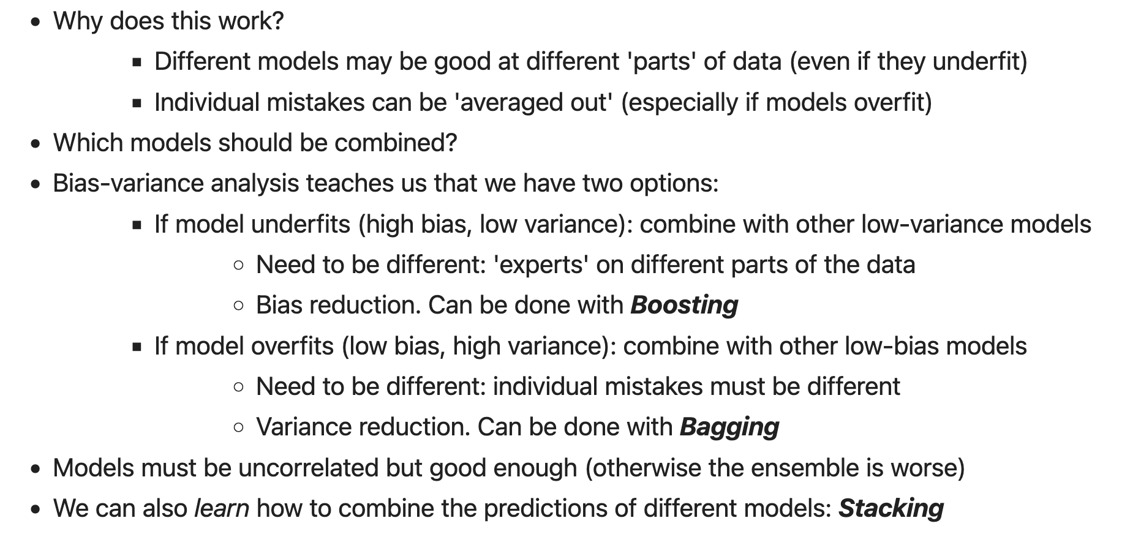

Slide 4
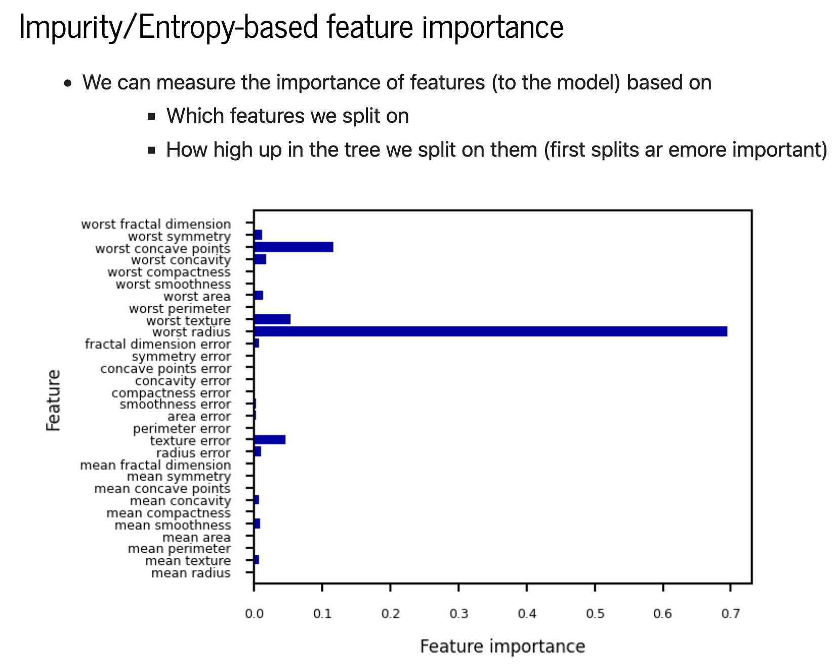

Slide 5
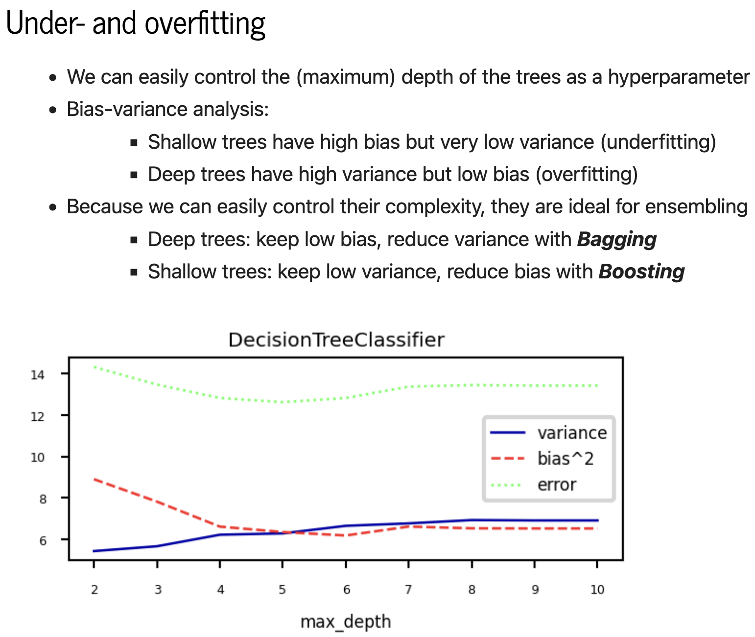

Slide 6
Introduction
Random Forests can be regarded as ensemble learning with decision trees
Instead of building a single decision tree and use it to make predictions, build many slightly different trees
Combine their predictions using majority voting
The main two concepts behind random forests are:
The wisdom of the crowd — a large group of experts are collectively smarter than individual experts
Diversification — a set of uncorrelated tress
A supervised machine learning algorithm
Classification (predicts a discrete-valued output, i.e. a class)
Regression (predicts a continuous-valued output) tasks.

Slide 7
History of Random Forests
Introduction of the Random Subspace Method
“Random Decision Forests” [Ho, 1995] and “The Random Subspace Method for Constructing Decision Forests” [Ho, 1998]
Motivation:
Trees derived with traditional methods often cannot be grown to arbitrary complexity for possible loss of generalization accuracy on unseen data.
The essence of the methods are to build multiple trees in randomly selected subspaces of the feature space.
Trees in, different subspaces generalize their classification in complementary ways, and their combined classification can be monotonically improved.
[Ho, 1995] Tin Kam Ho, "Random decision forests," Proceedings of 3rd International Conference on Document Analysis and Recognition, Montreal, QC, Canada, 1995, pp. 278-282 vol.1, doi: 10.1109/ICDAR.1995.598994.
[Ho, 1998] Tin Kam Ho, "The random subspace method for constructing decision forests," in IEEE Transactions on Pattern Analysis and Machine Intelligence, vol. 20, no. 8, pp. 832-844, Aug. 1998, doi: 10.1109/34.709601.

Slide 8
What is a Random Forest?
Combined the Random Subspace Method with Bagging. Introduce the term Random Forest (a trademark of Leo Breiman and Adele Cutler, 2001)
“Random Forests” [1]
The generalization error of a forest of tree classifiers depends on the strength of the individual trees in the forest and the correlation between them.
[Breiman, 2001] Breiman, Leo. "Random forests." Machine learning 45 (2001): 5-32.

Slide 9
What is a Random Forest?
We have a single data set, so how do we obtain slightly different trees?
1. Bagging (Bootstrap Aggregating):
Take random subsets of data points from the training set to create N smaller data sets
Fit a decision tree on each subset
Results in low variance.
2. Random Subspace Method (also known as Feature Bagging):
Fit N different decision trees by constraining each one to operate on a random subset of features

Slide 10


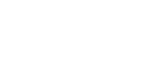




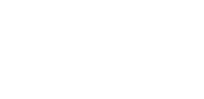

Bagging at training time
N subsets (with replacement)
Training set

Slide 11









Bagging at inference time
A test sample
75% confidence

Slide 12
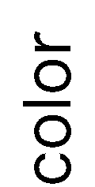


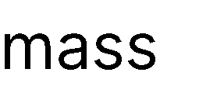










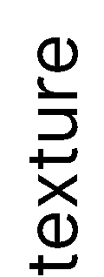
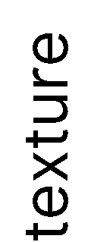















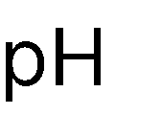



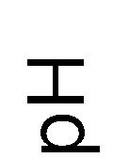

Random Subspace Method at training time
Training data

Slide 13






Random Subspace Method at inference time
A test sample
66% confidence

Slide 14

















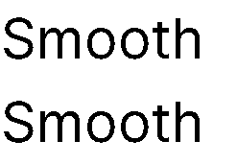








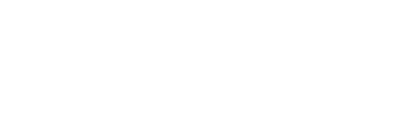

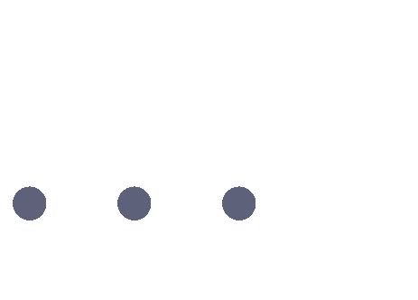






Random Forests
Tree 1
Tree 2
Random Forest
Tree N

Slide 15
Random Forests Algorithm
For b = 1 to B:
(a) Draw a bootstrap sample Z∗ of size N from the training data.
(b) Grow a random-forest tree to the bootstrapped data, by recursively repeating the following steps for each terminal node of the tree, until the minimum node size n_{min} is reached.
i. Select m variables at random from the p variables.
ii. Pick the best variable/split-point among the m.
iii. Split the node into two daughter nodes.
To make a prediction at a new point x we do:
For regression: average the results
For classification: majority vote
Output the ensemble of trees.

Slide 16
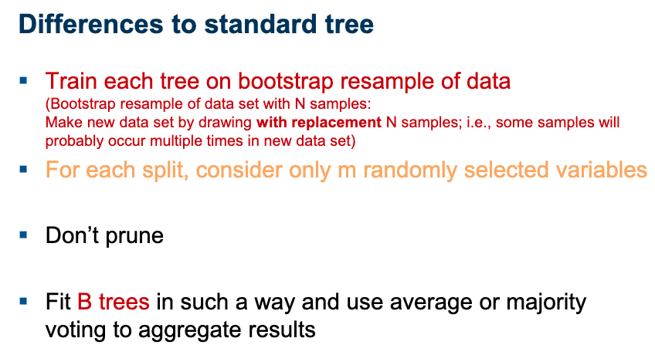

Slide 17
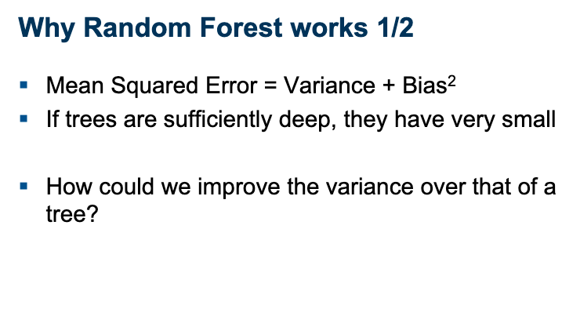

Slide 18
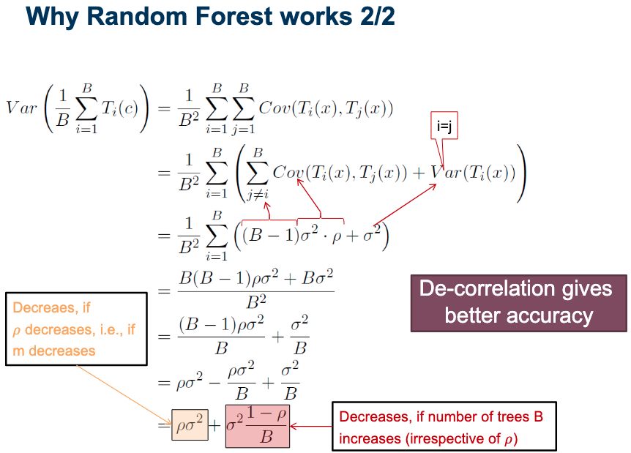

Slide 19
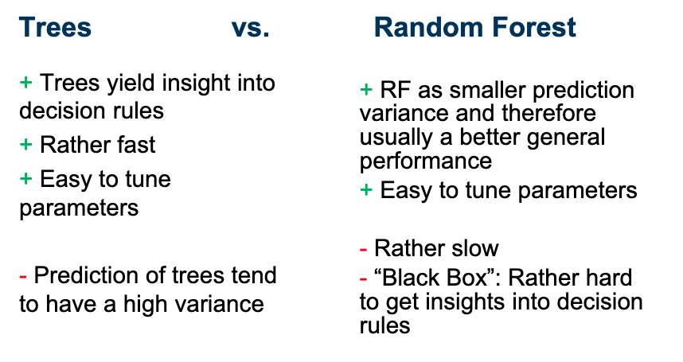

Slide 20
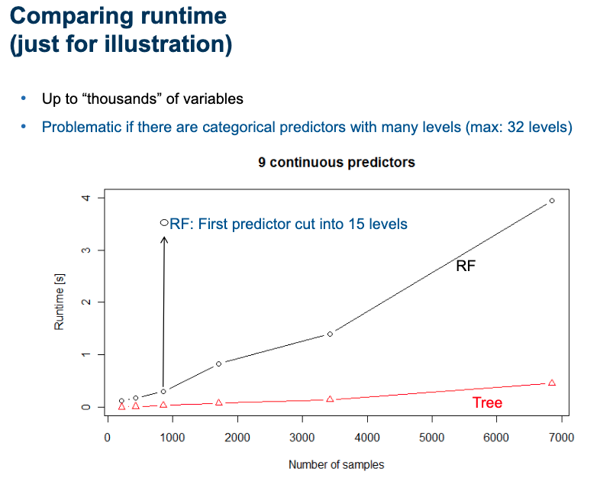

Slide 21
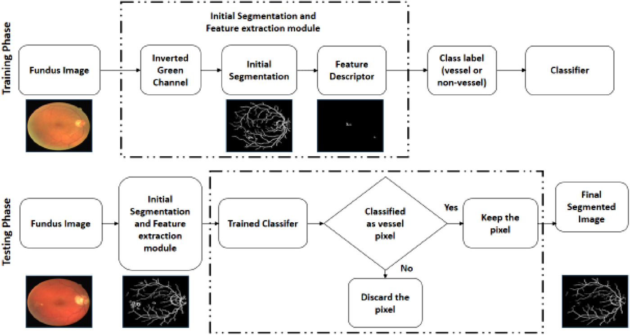
Case Study
An innovate approach for retinal blood vessel segmentation using mixture of supervised and unsupervised methods
IET Image Processing, Volume: 15, Issue: 1, Pages: 180-190, First published: 30 November 2020, DOI: (10.1049/ipr2.12018)

Slide 22
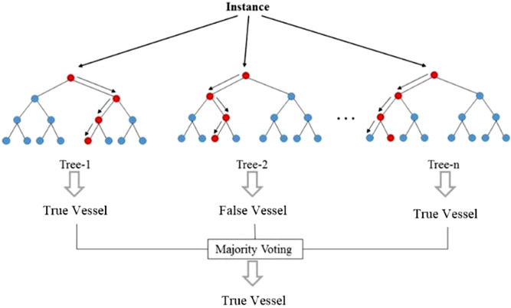
Case Study
An innovate approach for retinal blood vessel segmentation using mixture of supervised and unsupervised methods
IET Image Processing, Volume: 15, Issue: 1, Pages: 180-190, First published: 30 November 2020, DOI: (10.1049/ipr2.12018)

Slide 23
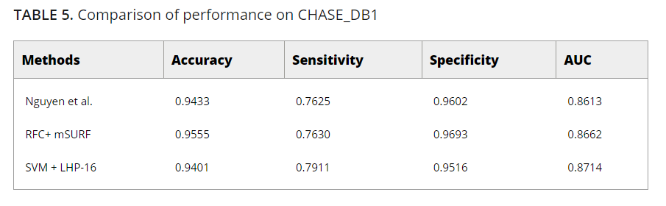
Case Study
An innovate approach for retinal blood vessel segmentation using mixture of supervised and unsupervised methods
IET Image Processing, Volume: 15, Issue: 1, Pages: 180-190, First published: 30 November 2020, DOI: (10.1049/ipr2.12018)

Slide 24
Why a Random Forest?
Accurate predictions
Standard decision trees often have high variance and low bias High chance of overfitting (with ‘deep trees’, many nodes)
With a Random Forest, the bias remains low and the variance is reduced thus we decrease the chances of overfitting
Flexible
Can be used with many features
Can be used for classification but also for regression
Disadvantages:
When the number of variables is large, but the fraction of relevant variables is small, random forests are likely to perform poorly when m is small

Slide 25
Using random features
Random split selection does better than bagging; introduction of random noise into the outputs also does better; but none of these do as well as Adaboost by adaptive reweighting (arcing) of the training set.
To improve accuracy, the randomness injected has to minimize the correlation while maintaining strength.
The forests consists of using randomly selected inputs or combinations inputs at each node to grow each tree.

Slide 26
Using random features (Cont.)
Compared with Adaboost, the forests discussed here have following desirable characteristics:
--- its accuracy is as good as Adaboost and sometimes better;
--- it’s relatively robust to outliers and noise;
--- it’s faster than bagging or boosting;
--- it gives useful internal estimates of error, strength, correlation and variable importance;
--- it’s simple and easily parallelized.

Slide 27
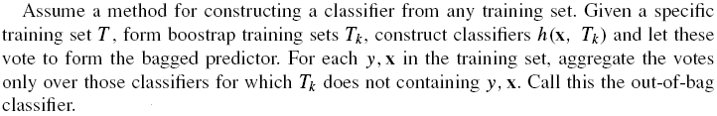
Using random features (Cont.)
The reason for using out-of-bag estimates to monitor error, strength, and correlation:
--- can enhance accuracy when random features are used;
--- can give ongoing estimates of the generalization error (PE*) of the combined ensemble of trees, as well as estimates for the strength and correlation.

Slide 28
Random forests using random input selection (Forest-RI)
The simplest random forest with random features is formed by selecting a small group of input variables to split on at random at each node.
Two values of F (number of randomly selected variables) were tried: F=1 and F= int( ), M is the number of inputs.
Data set: 13 smaller sized data sets from the UCI repository, 3 larger sets separated into training and test sets and 4 synthetic data sets.

Slide 29
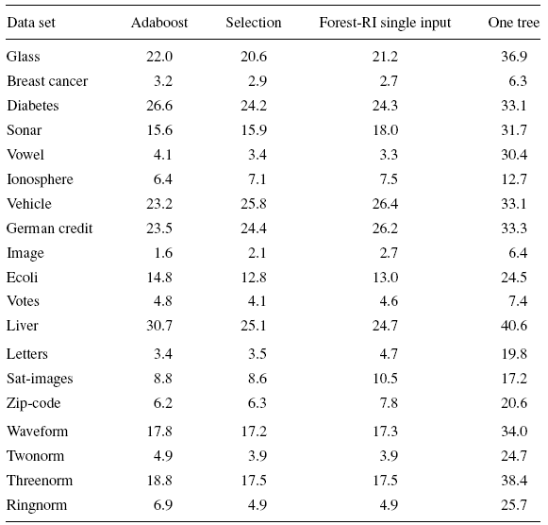
Forest-RI (Cont.)

Slide 30
Forest-RI (Cont.)
2nd column are the results selected from the two group sizes by means of lowest out-of-bag error.
3rd column is the test error using one random feature to grow trees.
4th column contains the out-of-bag estimates of the generalization error of the individual trees in the forest computed for the best setting.
Forest-RI > Adaboost.
Not sensitive to F.
Using a single randomly chosen input variable to split on at each node could produce good accuracy.
Random input selection can be much faster than either Adaboost or Bagging.

Slide 31
Random forests using linear combinations of inputs (Forest-RC)
Defining more features by taking random linear combinations of a number of the input variables.
A feature is generated by specifying L, the number of variables to be combined.
At a given node, L variables are randomly selected and added together with coefficients that are uniform random numbers on [-1,1].
F linear combinations are generated, and then a search is made over these for the best split. This procedure is called Forest-RC.
We use L=3 and F=2,8 with the choice for F being decided on by the out-of-bag estimate.

Slide 32
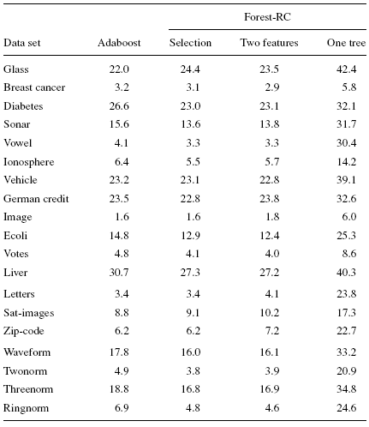
Forest-RC (Cont.)
The 3rd column contains the results for F=2.
The 4th column contains the results for individual trees.
Overall, Forest-RC compares more favorably to Adaboost than Forest-RI.

Slide 33
Empirical results on strength and correlation
To look at the effect of strength and correlation on the generalization error.
To get more understanding of the lack of sensitivity in PE* to group size F.
Using out-of-bag estimates to monitor the strength and correlation.
We begin by running Forest-RI on the sonar data (60 inputs, 208 examples) using from 1 to 50 inputs. In each iteration, 10% of the data was split off as a test set. For each value of F, 100 trees were grown to form a random forest and the terminal values of test set error, strength, correlation are recorded.

Slide 34
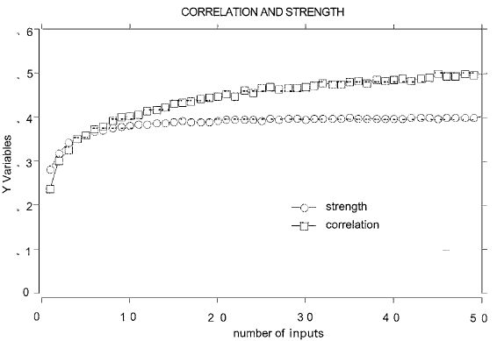
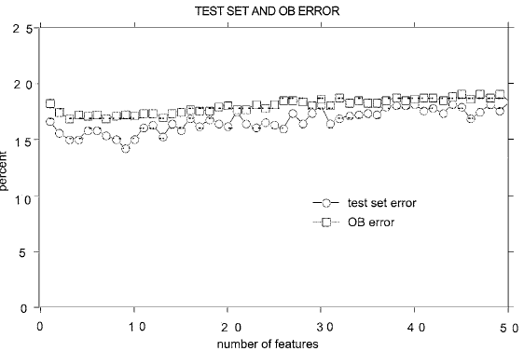

Slide 35
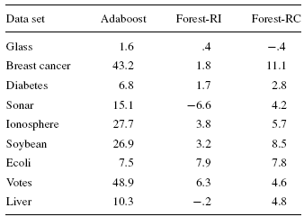
The effects of output noise
Dietterich (1998) showed that when a fraction of the output labels in the training set are randomly altered, the accuracy of Adaboost degenerates, while bagging and random split selection are more immune to the noise. Increases in error rates due to noise:

Slide 36
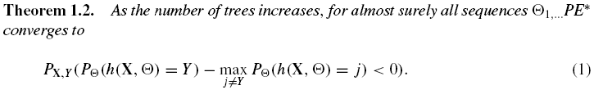
Characterizing the accuracy of RF
Margin function:
which measures the extent to which the average number of votes at X,Y for the right class exceeds the average vote for any other class. The larger the margin, the more confidence in the classification.
Generalization error:

Slide 37


Characterizing the accuracy of RF
Margin function for a random forest:
strength of the set of classifiers is
suppose is the mean value of correlation
the smaller,
the better

Slide 38
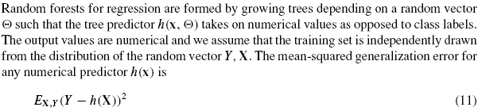

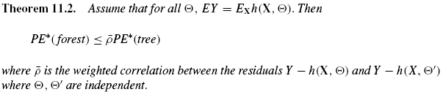
Random forests for regression

Slide 39
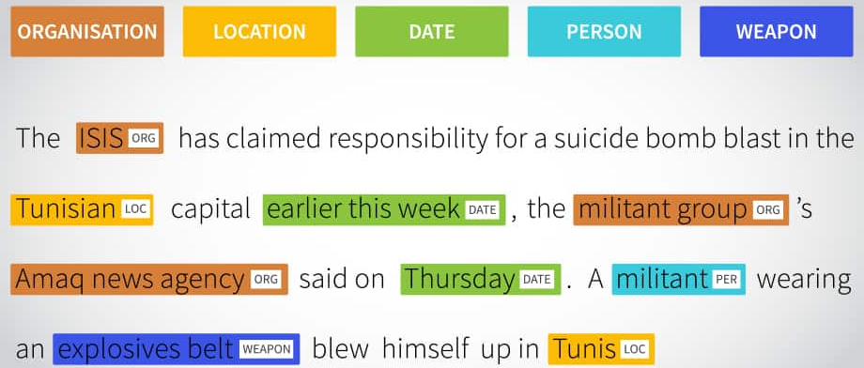
End-to-end Example for BI!
Named-Entity Recognition

Slide 40
Named Entity Recognition
Subtask of Information Extraction
Identify known entity names – person, places, organization etc
Identify the boundaries of the NE and identify its types
Example:
Input - Pope Benedict , the leader of the Catholic church wants to retire in Rome.
Output - [PER Pope Benedict XVI], the leader of [ORG the Catholic church] wants to retire in [LOC Rome].
Notes:
Information extraction is the process of extracting some structured information from unstructured text.

Slide 41
Proposed Technique – Random Forests! ☺
Random Forest
Ensemble of trained decision trees
Bootstrapping– Randomly sample the labelled training data
Bayesian optimization (New!)
To set hyperparameter values
Notes:
NER is a sequence labelling task and techniques like HMM, MEMM, CRFs look more suitable for this task. But decision trees take less computation time and enables to use enormous feature set.

Slide 42
Dataset
Using Reuters corpus available in NLTK instead
Contains 10,788 news documents totalling 1.3 million words
We use 5000 sentences, about 10% of total data.
We use the NLTK NER tagger as gold standard [noisy!]

Slide 43
Features
We extracted 11 features from our corpus.
Orthographical:
Capitalization, word length, digits, dashes, …
Contextual:
Part of speech tags
Gazetteer lists:
Unambiguous NEs from training
Locations, names, corporate names

Slide 44
Unbalanced data
Highly unbalanced data
Most words are not named entities (i.e. in class 0)
Risk of a strong bias towards class 0.
Solution:
Undersample 0-class in training data.
Use all data from other classes.
Creates extra bootstrapping parameter B.

Slide 45
Random forest
We use 10-fold cross validation to evaluate our model’s performance
Metrics
Precision & recall
F-measure
Accuracy is uninformative
How to choose hyper-parameter values?
# of trees, max depth, # of features, B
Answer: Bayesian optimization

Slide 46
Bayesian optimization
Grid search optimization is too expensive!
Bayesian optimization greatly reduces number of model evaluations:
Assume Gaussian process prior
Updates a GP posterior on each iteration
Different heuristics for picking points:
We optimize Expected Improvement
We use Spearmint B.O. package by Snoek et al.

Slide 47
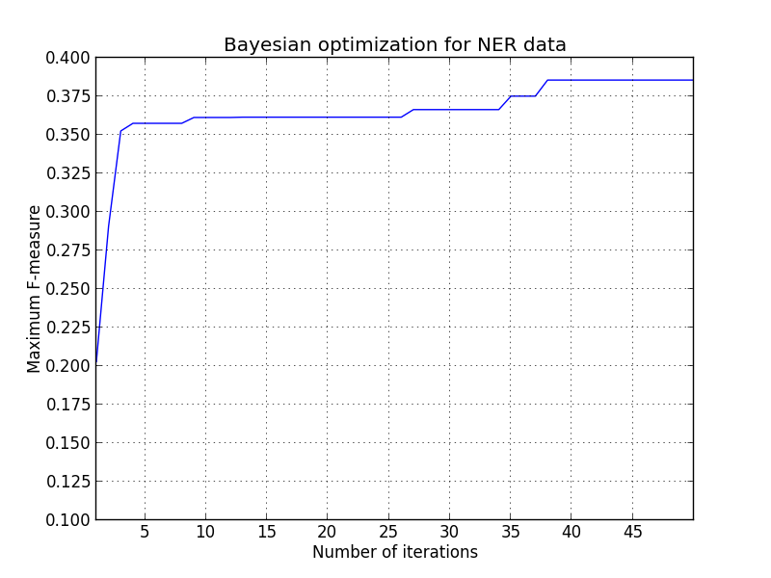
Experiments and results
Optimal values:
B = 0.093408…
#features = 8
max_depth = 7

Slide 48
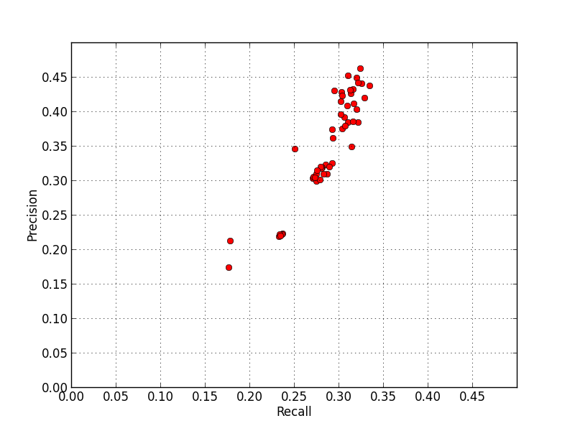
Experiments and results
Precision-recall curve for each iteration of Bayesian optimization
Unexpected proportional relationship!

Slide 49

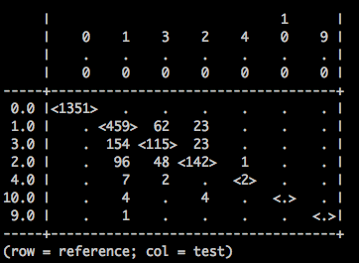
Experiments and results
Random forest with optimal hyper-parameters
Sample confusion matrix

Slide 50
Conclusions
Random forests are a feasible model for doing NER
Bayesian optimization is a powerful way of optimizing hyper-parameters
This work could benefit from:
Better NER tags in training data
More features (i.e. n-grams)
More data for training – now using 160,000 words

Slide 51
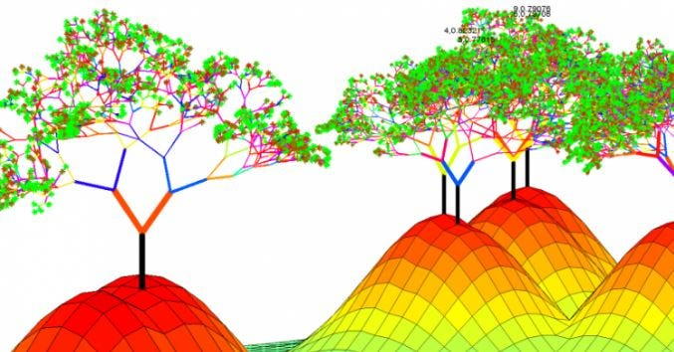
Questions?
Questions?

Slide 52
References
[1] Breiman, Leo. "Random forests." Machine learning 45 (2001): 5-32.
[2] Faculty of Mathematics and Computer Science, University of Bucharest. (n.d.). Practical Machine Learning [Decision Trees, Random Forests]. Practical Machine Learning. Retrieved May 1, 2023, from https://practical-ml-fmi.github.io/ML/
[3] Pramoditha, R. (2020, October 29). Random forests - an ensemble of decision trees. Medium. https://towardsdatascience.com/random-forests-an-ensemble-of-decision-trees-37a003084c6c

